Slide 1
CSE332 INDUSTRY ETHICS AND LEGAL ISSUES

Slide 2
- Creating an ethical work environment - Ethical decision making

Slide 3
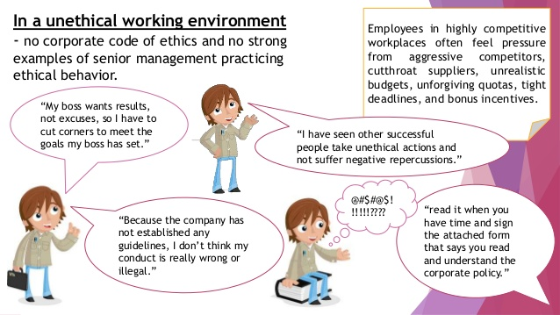
Creating an Ethical Work Environment

Slide 4
Creating an Ethical Work Environment
Employees must have knowledgeable resource
To discuss the perceived unethical practices

Slide 5
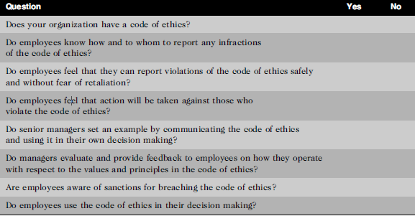
Creating an Ethical Work Environment
Manager’s checklist for establishing an ethical work environment

Slide 6

DECISION

Slide 7

DECISION MAKING

Slide 8
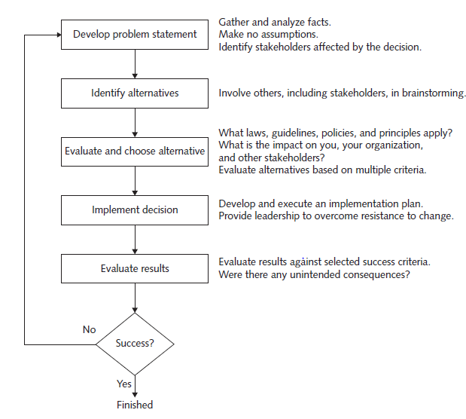
INCLUDING ETHICAL CONSIDERATIONS IN DECISION MAKING

Slide 9
DEVELOP A PROBLEM STATEMENT
Clear and concise description of issue to be addressed.
Who is directly affected by the problem?
Is anyone else affected?
How often does the problem occur?
What is the impact of the problem?
How serious is the problem?

Slide 10
IDENTIFY ALTERNATIVES
Include stakeholders
Brainstorming with others increase chances of identifying
a broad range of alternatives and determining best solution.
Try not to be critical of ideas,
As negative criticism will shut down the discussion,
flow of ideas will dry up.
Simply write ideas as they suggested.

Slide 11
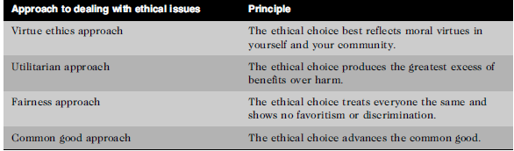
EVALUATE AND CHOOSE AN ALTERNATIVE

Slide 12
IMPLEMENT THE DECISION
Once alternative is selected, implement it in
effective
efficient
timely manner.
What is wrong with old way we do things?
What are benefits of new way for you?

Slide 13
EVALUATE THE RESULTS
Were the success criteria fully met?
Were there any unintended consequences?

Slide 14
Next Topics:
Ethics in Information Technology
Ethical behavior of IT professional
Common ethical issues for IT users
Supporting the ethical practices of IT users

